Slide 1
Learning Aim F
Quality Management

Slide 2
Quality Management
The process where businesses put systems in place to ensure the quality of their product or service is consistent.
There are regulated quality standards, such as BS 7850-1:1992 and ISO 9000:2015

Slide 3
British Standards Institution standard BS 7850-1:1992
The standard known as BS 7850-1 is a guide for management principles on how to organise the business structure.
TQM (Total Quality Management) is designed to involve the whole company in evaluating what works well and what they need to improve.
TQM aims to makes best use of the company’s resources, including the workforce, to meet business objectives.
e.g. Finance check the budget and order materials, production check the workforce have the capacity, operations check that this work does not affect other deadlines, transport check they can deliver

Slide 4
International Organization for Standardization standard ISO 9000:2015
Internationally recognised for both quality management and quality assurance.
There are many parts to the ISO standards and these are mainly concerned about assuring statutory laws and regulations are being met.
It is the most widely used quality standard internationally but like most quality systems is often blamed for being overly-bureaucratic and costly.

Slide 5



Slide 6
Developing a quality culture
The impact of a quality system should improve business practice and not generate a paper-work overload.
Criticised for too much bureaucracy
Requires employees to be diligent and conscientious of following the procedures
Setting quality standards – based on quality control (QC) and quality assurance (QA)
QC processes occur between input and output, and before the production process begins (i.e planning stage)
QA relates to all those planned and systemic actions needs to provide confidence that they will meet the requirements for quality

Slide 7
Developing a quality culture
The change in the way employees work will impact the culture and it might be the reason why a business is now seeking a quality management accreditation
If the business is not cost effective
There is too much waste
Customer complaints are high
Inefficient workforce practices
A framework is provided to guide businesses in all aspects of business operations:
Instructions for every operation of the business
Complaints and grievances
Recruitment and selection
How each operation is monitored and reviewed
Finance operations
Each business will tailor their quality framework and standards depending on several factors, including type of business, where they operate etc.

Slide 8
Developing a quality culture
Managerial commitment and staff buy-in
Staff need to not resist change, and be willing and committed to the business’ objectives in order for managers to be able to implement the change
Managers need to show commitment as they are the ones who are responsible for deciding on the quality standard and how to implement them.
Quality circles
A way of involving employees, usually in the same department or who have similar job roles, with problem-solving and resolutions.
Effective and efficient way of getting to the bottom of the problem by listening to those most closely related, as managers are often too far removed from day-to-day operations

Slide 9
Developing a quality culture
Partnership working with suppliers and customers
Government are keen to encourage partnership working and it continues to feature in their directives to businesses.
Benefits:
Stakeholders feeling listened to concerning what they want and expect
Learning from mistakes and looking for ways to improve
Gaining trust from stakeholders
Gaining in competitiveness on a wider scale
Learning new ways to put things right
Being able to outsource specialist operations
Diversifying products and services
Contributing to the economy on a global scale
Ensuring sustainability

Slide 10
Developing a quality culture
Transparent and open communication
For example, encouraging staff to own up to mistakes so that improvements can be made and to avoid any culture of blame and deceit
Used in Google and HP
The police rely on this to provide their service – they now have a Police National Database so all information is shared across regions.

Slide 11
The Techniques and Tools of Quality Management
Quality Control
Concerned with ensuring that all products and services are an acceptable quality standard.
USA vehicle industry in the 1940s had whole quality departments dedicated to just one component of the car
Japanese market for cars has showed its competitive and quality nature and was possibly instrumental in changing the way industry viewed quality

Slide 12
The Techniques and Tools of Quality Management
Lean Manufacturing
Ensures maximum value for minimum waste – Toyota in mid 1980s
Purpose: what customer problems will the enterprise solve to achieve its own purpose of prospering?
Process: how will the organisation assess each major value stream to make sure each step is valuable, capable, available, adequate, flexible, and that all steps are linked by flow, pull, and levelling?
People: how can the organisation ensure that every important process has someone responsible for continually evaluating that value stream in terms of business purpose and lean process? How can everyone touching the value steam be actively engaged in operating it correctly and continually improving it?

Slide 13
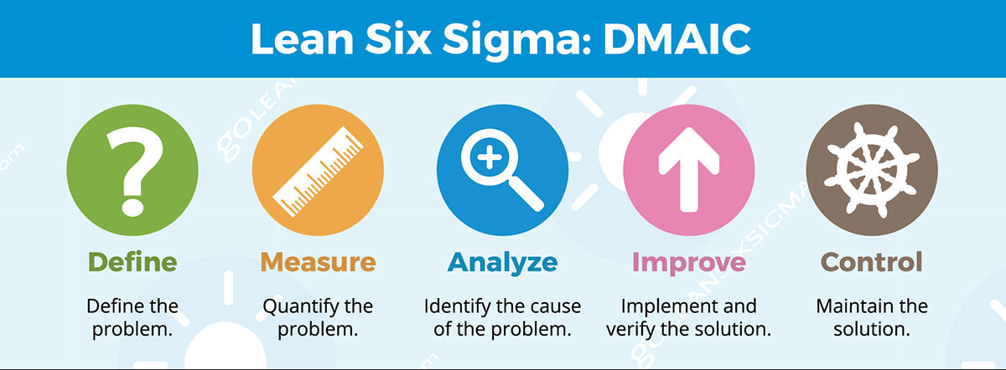
The Techniques and Tools of Quality Management
Six Sigma
Quality techniques and tools for process improvement
Data driven approach and methodology for eliminating defects
Quality framework that a business with progress through, with the intention of reducing wasted time

Slide 14
The Importance and Benefits of Quality Management
Zero Defect Production and Output
Produce materials with zero defects, stemming from the work of a highly skilled workforce
Benefits:
Maximum profit
Customer satisfaction
Rapid production
Deadlines being met
To achieve this, every member of the workforce needs to understand the part they play and that they are responsible for their contribution

Slide 15
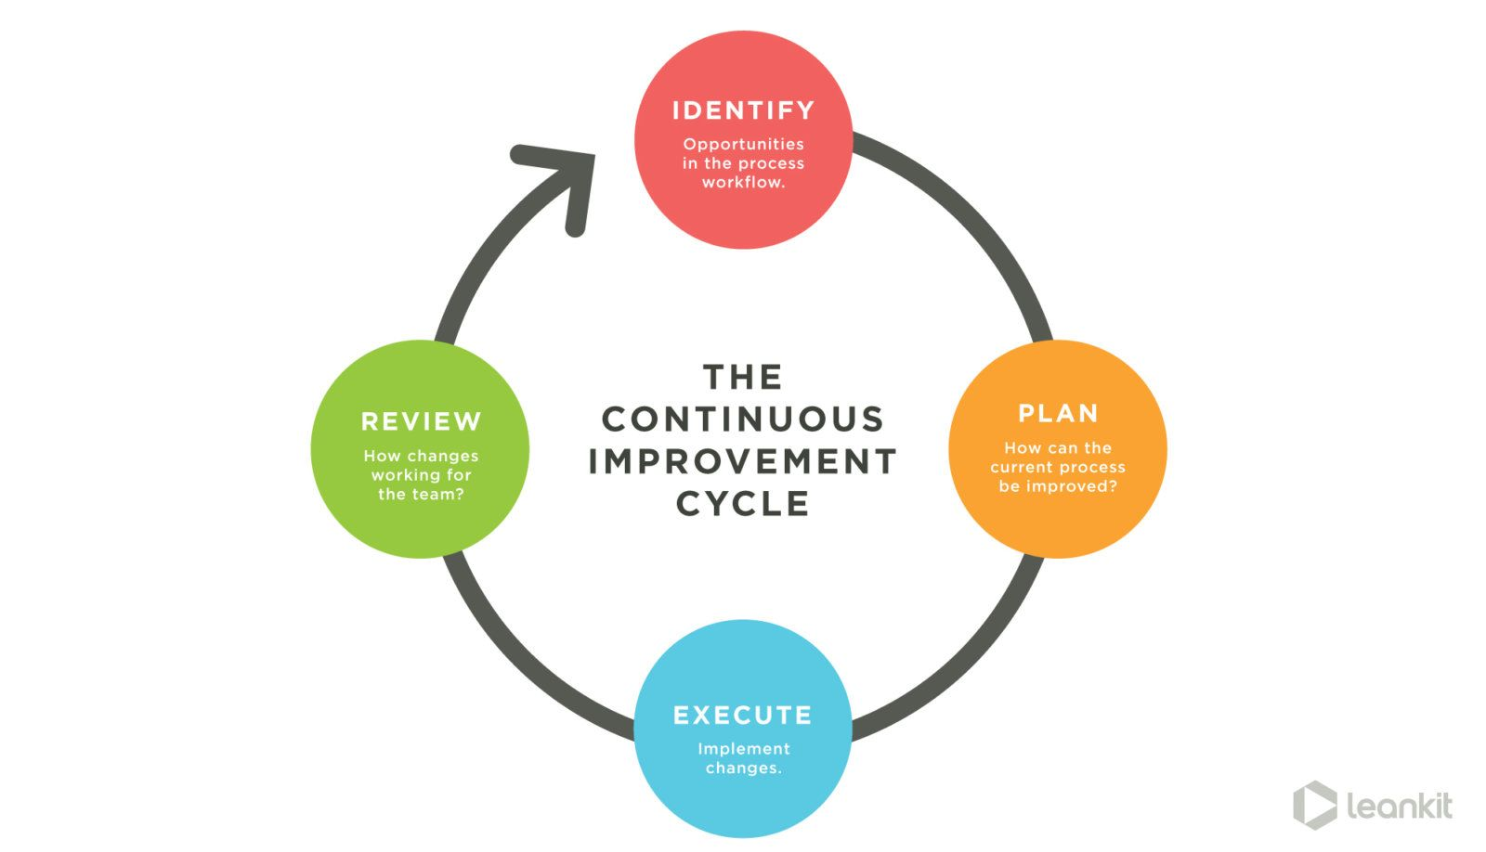
The Importance and Benefits of Quality Management
Continuous Improvement
Businesses will continuously monitor, review and evaluate their processes to look for ways to improve

Slide 16
The Importance and Benefits of Quality Management
Improved Output Quality
A benefit of continuous improvement is having products and services of an improved quality.
Reduced Inspection Requirements
Businesses who are able to demonstrate their ongoing commitment to continuous improvement are likely to experience fewer external inspections from regulators e.g. Iip, BSI, ISO, Ofsted
Regulators need to be satisfied that the business has a consistent track record of improvement
Supplier Engagement Satisfaction
Engaging with suppliers requires a strategy which leads to supplier satisfaction – Supply Chain Management
If the business does not have reliable suppliers, it either fails or has to find a better alternative.

Slide 17
The Importance and Benefits of Quality Management
Customer Involvement Satisfaction
Beneficial for businesses and more likely to lead to customer satisfaction
The use of social media is important here, particularly Facebook and Twitter which invite customers to be involved and make recommendations
Customers are now informed of improvements to the business
Businesses often use customer feedback as part of a continuous improvement, taking on feedback from a variety of sources e.g. feedback cards, online reviews, focus groups etc.

Slide 18
The Importance and Benefits of Quality Management
Improved Efficiency and Profitability
Quality systems can generate complaints from employees where they are not understood or not well planned, so place a burden on the workforce.
Systems are not all about paperwork, but some is essential to track what is happening in an organisation
Overall aim and benefit from quality management are improved efficiency and profitability.
Businesses that operate without clear guidance from management about the processes workers should follow are likely to fail.

